Slide 1
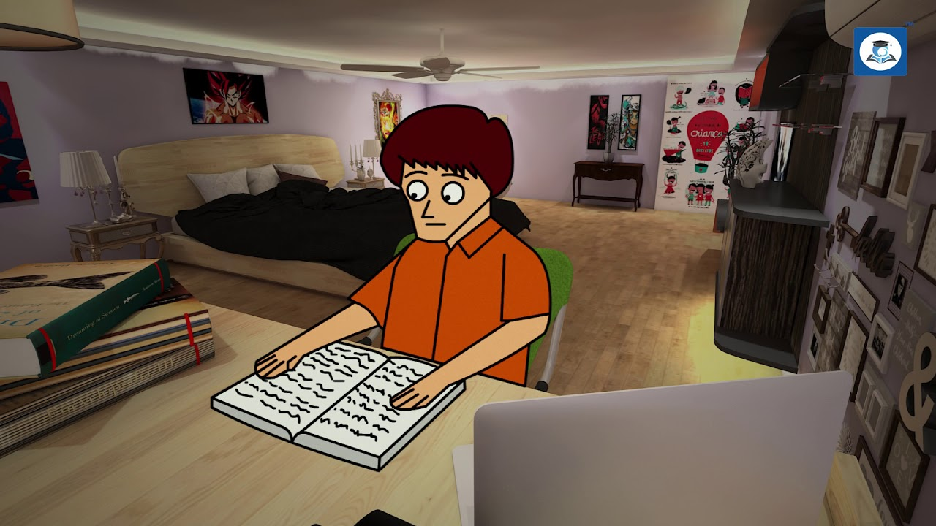
Carol Moore

Slide 3
Important Characters
Patrick
Teacher
Cat
Elf

Slide 4
Introduction
‘Who did Patrick’s Homework?’ is a wonderful story about a boy named Patrick who gets inspired and feels motivated to work hard by an imaginary elf (a supernatural being). He is not only able to complete his work but also scores high grades. This story conveys the message that ‘ Self help works wonders.’

Slide 5
ELF
(an imaginary being, often like a small person with pointed ears, in popular stories)

Slide 6
Summary
Patrick was an active boy who loved outdoor games like hockey and basketball. He was an enthusiastic player but somehow was not interested in studies. Because of his poor interest in studies, he shirked work and was warned strictly by his teacher. One day Patrick observed his cat playing with a doll. But when he looked at it closely, he found that it was a small-sized man-elf (a supernatural being). He was wearing a woolen shirt, a tall hat and breeches. He was scared of a cat and needed help. He pleaded (requested) Patrick to save him and in return he promised to grant him a wish.
Patrick felt happy and called himself a fortunate one. He asked the elf to do his homework in return. Though the elf was not ready for it yet, he offered to do this for him for 35 days (one semester).

Slide 7
Summary Contd…
However, a problem arose when the elf told that he knew nothing of maths and history. He needed help to do these subjects. Patrick agreed and brought many books to read and consult. He sat next to elf and put in a hard to complete the work.
Exactly after 35 days when the semester was over, the elf went away quietly. Patrick scored grade ‘A’ in all the subjects. Everyone appreciated him. He became a very different person who was hardworking, generous and an exemplary boy.
Patrick thought it is elf who helped him score high but in reality, it was Patrick himself who did all the good and changed his score.

Slide 8
Moral of the Story
The moral of this story is “Hard work is only the key to success”. We should always do our work by ourselves. We should not be dependent on others for our work. Patrick learnt this value and started to do his homework.

Slide 9
WORDS MEANING
Nintendo: a video game Ignoramus: an ignorant person, who lacks education grabbed : caught tiniest : smallest
Lucky:: fortunate problems: difficulties semester: a half or quarter term in school or university

Slide 10
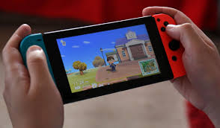
Nintendo

Slide 11
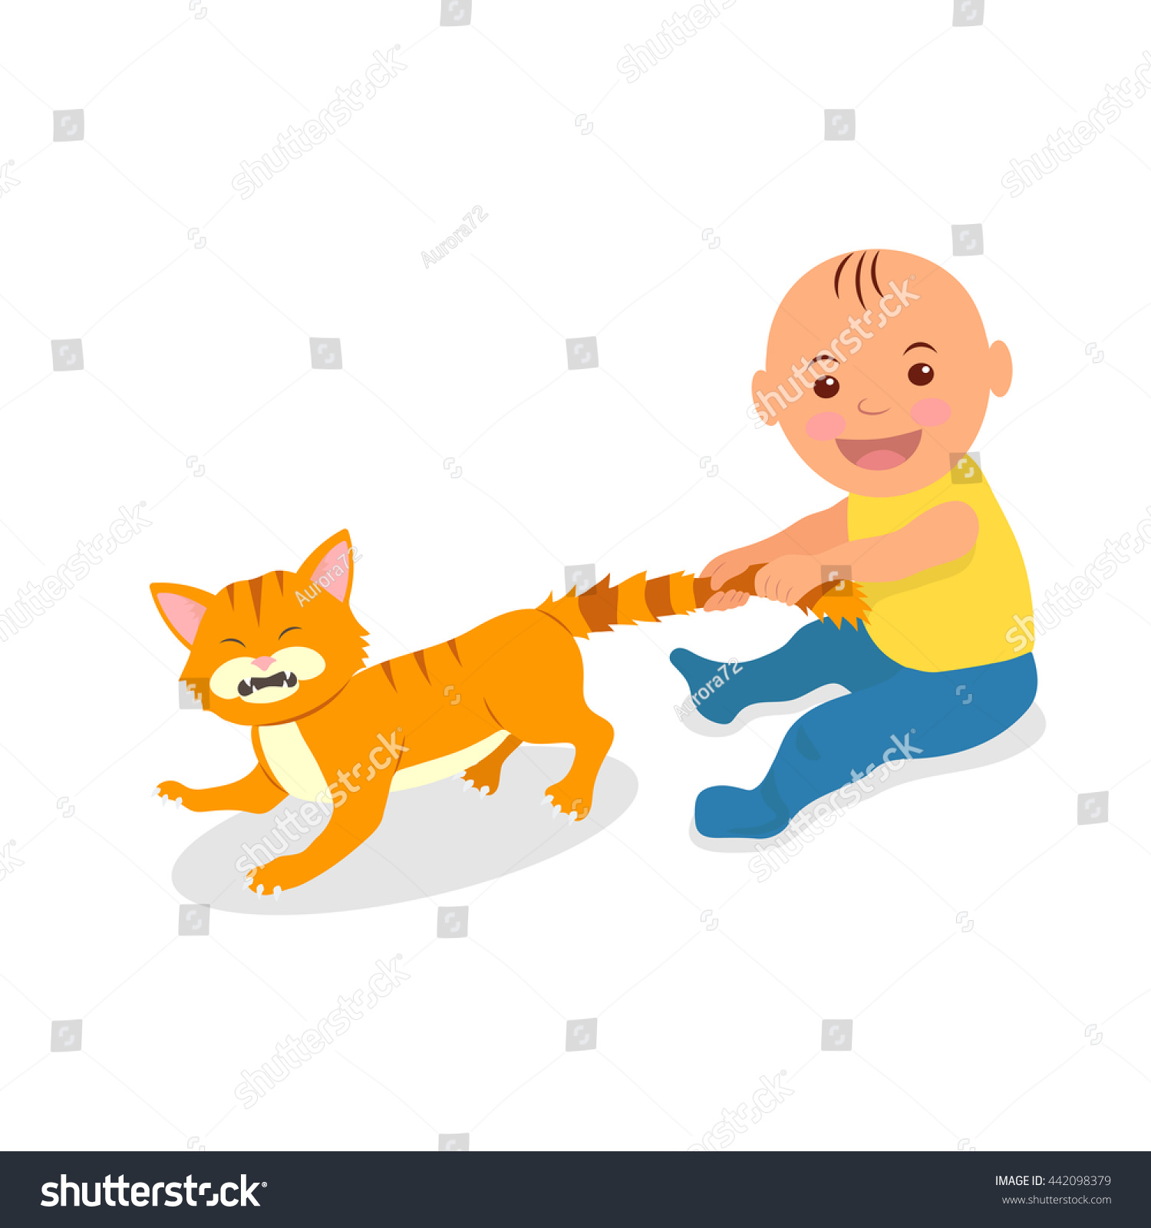
Grabbed

Slide 12
WORDS MEANING
dishcloth: a cloth used for washing dishes hamper: a basket with a lid Wrinkled : slight folds on skin because of old age Cursed: Ill fated
elf : a super -natural creature

Slide 13
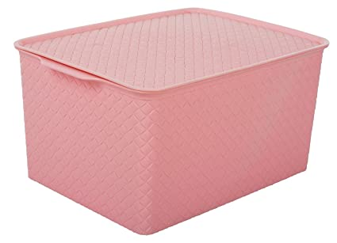
Hamper

Slide 14
WORDS MEANING
child chores: work that must be done everyday, often boring attitude: a feeling about someone or something amazed: surprised
shrieked: gave a short, high-pitched cry
nag: one who troubles someone all the time by complaining or asking them to do something drag (an informal word): something dull and uninteresting Weary : extreme tiredness Bleary.: looking dull because of tiredness

Slide 15
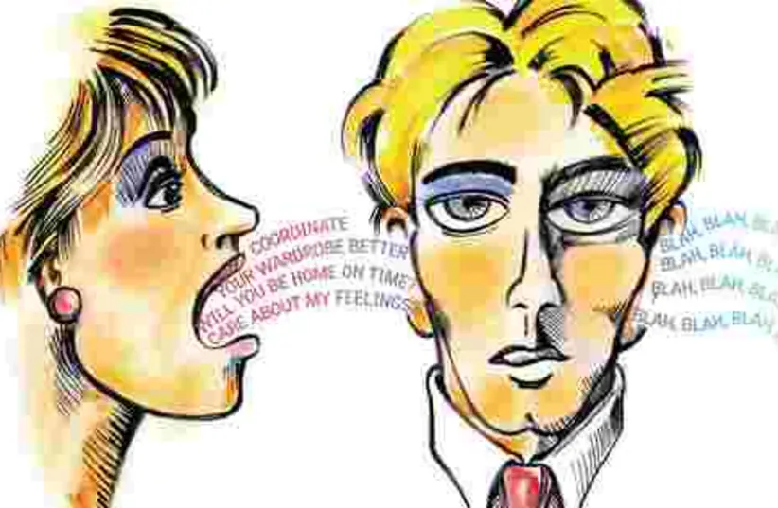
Nag

Slide 16
Bleary

Slide 17
Patrick never did homework. "Too boring," he said.
Explanation
He played baseball and basketball and Nintendo instead.
His teachers told him, "Patrick! Do your homework or you won't learn a thing." And it's true, sometimes he did feel like a ding-a-ling.
But what could he do? He hated homework.

Slide 18
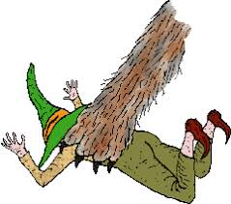
Then on St. Patrick's Day his cat was playing with a little doll and he grabbed it away.
To his surprise it wasn't a doll at all, but a man of the tiniest size. He had a little wool shirt with old fashioned britches and a high tall hat much like a witch's.
He yelled, "Save me! Don't give me back to that cat. I'll grant you a wish, I promise you that."

Slide 19
Patrick couldn't believe how lucky he was! Here was the answer to all of his problems.
So he said, "Only if you do all my homework 'til the end of the semester, that's 35 days. If you do a good enough job, I could even get A's.“
The little man's face wrinkled like a dishcloth thrown in the hamper.
He kicked his legs and doubled his fists and he grimaced and scowled and pursed his lips, "Oh, am I cursed! But I'll do it."

Slide 20
And true to his word, that little elf began to do Patrick's homework. Except there was one glitch. The elf didn't always know what to do and he needed help. "Help me! Help me!" he'd say. And Patrick would have to help -- in whatever way.
"I don't know this word," the elf squeeked while reading Patrick's homework. "Get me a dictionary. No, what's even better. Look up the word and sound it out by each letter."

Slide 21
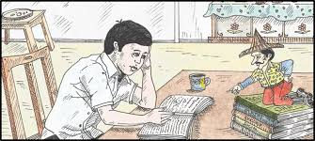

Slide 22
When it came to math, Patrick was out of luck. "What are times tables?" the elf shrieked. "We elves never need that. And addition and subtraction and division and fractions? Here, sit down beside me, you simply must guide me.“
Elves know nothing of human history, to them it's a mystery. So the little elf, already a shouter, just got louder "Go to the library, I need books. More and more books. And you can help me read them too."

Slide 23
As a matter of fact every day in every way that little elf was a nag! Patrick was working harder than ever and was it a drag! He was staying up nights, had never felt so weary, was going to school with his eyes puffed and bleary.
Finally the last day of school arrived and the elf was free to go. As for homework, there was no more, so he quietly and slyly slipped out the back door.

Slide 24
Patrick got his A's; his classmates were amazed; his teachers smiled and were full of praise. And his parents? They wondered what had happened to Patrick. He was now the model kid. Cleaned his room, did his chores, was cheerful, never rude, like he had developed a whole new attitude.

Slide 25
You see, in the end Patrick still thought he'd made that tiny man do all his homework. But I'll share a secret, just between you and me. It wasn't the elf; Patrick had done it himself!

